Slide 1
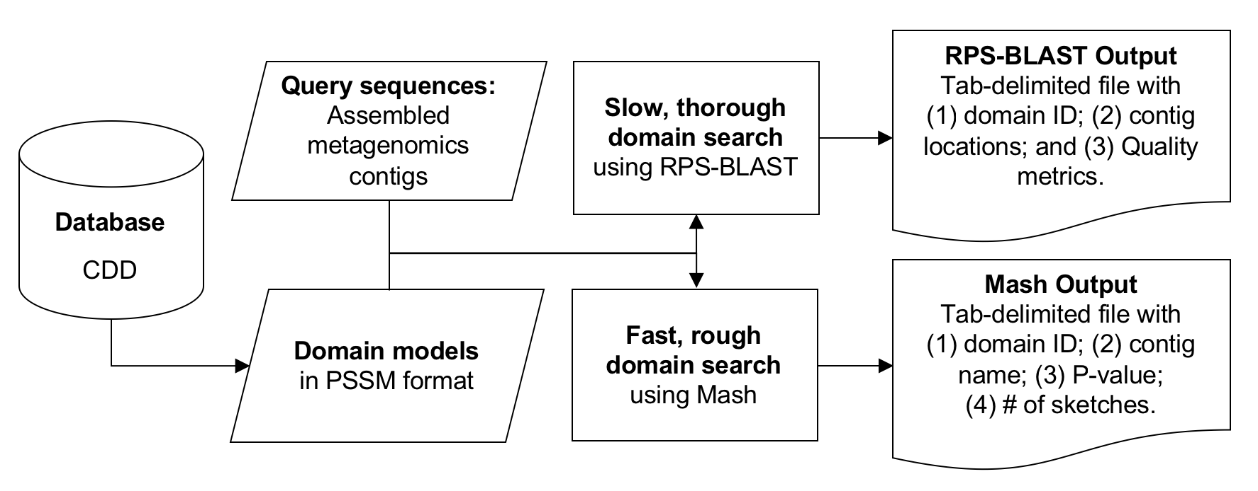
Domain search workflow

Slide 2
Protein domains search pipeline
~3k datasets with
assembled contigs
Inputs:
the (assembled) contigs
protein domain models
✘ ~300k CDD, no PFAM, POGs, etc. to avoid later work in filtering overlapping hits
✓ ~2k “viral”-enriched set from Rodney

Slide 3
Protein domains search pipeline
~3k datasets with
assembled contigs
Inputs:
the (assembled) contigs
protein domain models
✘ ~300k CDD, no PFAM, POGs, etc. to avoid later work in filtering overlapping hits
✓ ~2k “viral”-enriched set from Rodney

Slide 4
General CDD hit stats
Total | 1e-3 | 1e-10
2,997 SRRs | 2,745 hits | 2,534
55,503,968 contigs | 5,606,754 (10%) | 278,725 (0.5%)
2,082 CDDs | 2,079 CDDs | 1,263 CDDs
77,3% of contigs = only 1 CDD hit

Slide 5
Protein domains search pipeline
~3k datasets with
assembled contigs
~100k datasets with
non-assembled reads
Inputs:
the (assembled) contigs
protein domain models
✘ ~300k CDD, no PFAM, POGs, etc. to avoid later work in filtering overlapping hits
✓ ~2k “viral”-enriched set from Rodney
Inputs:
the (non-assembled) reads
protein domain models
but...how to connect?
k-mers – build our own method?
min-hash, if it would work?
?Dataset clustering?

Slide 6
Kmer-6
500
Common (very low …)
Rpstbln
mash

Slide 7
Kmer-6
rpstbln
Mash

Slide 8
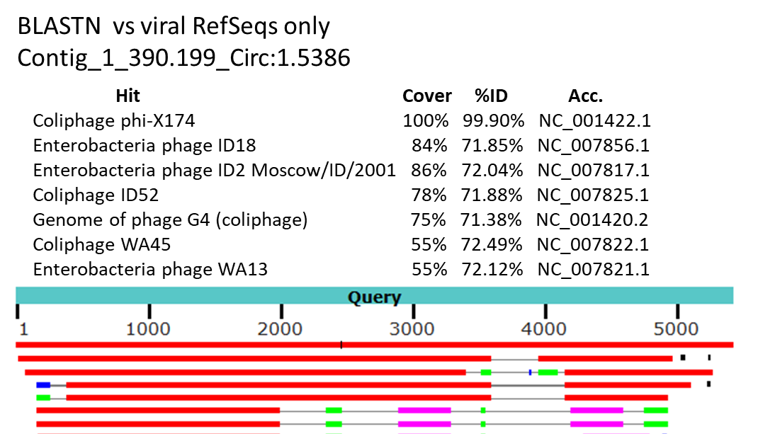
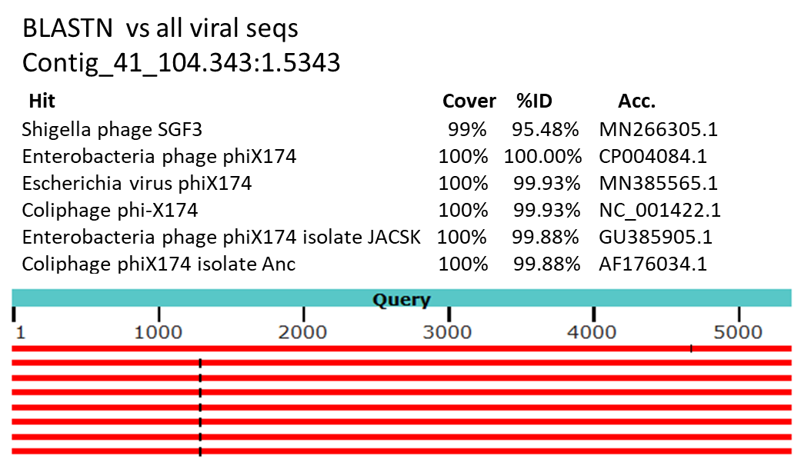
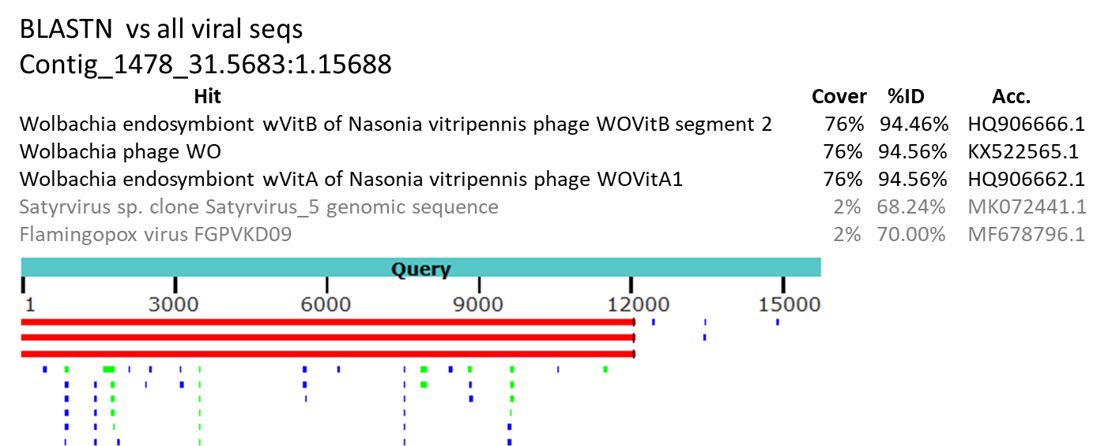
Selected 3 contigs with highest number of CDD hits

